Slide 1
CHAPTER 13
STRESS

Slide 2
Introduction:
A dynamic condition in which an individual is confronted with an opportunity, constraint or demand related to what he or she desires for which the outcome is perceived to be both uncertain and important.
Stress has been defined as a physical, mental or emotional response to events which cause mental or bodily tension. At the same time, it should not exceed the capacity of an individual to handle it.
Stress refers to a psychological and physiological state that results when certain features of an individual’s environment challenge that person, creating an actual or perceived imbalance between demand and capability to adjust that results in a non specific response.

Slide 3
Types of Stress:
Physical - This happens when the body as a whole suffers due to stressful situation. Symptoms are headaches, BP , ulcers, digestive problems, hair fall, excessive sweating.
Emotional - These responses are due to stress affecting the mind and include anxiety, depression, over reaction, memory loss, less concentration.
Psychological – Long term stress can cause psychological problems in some individuals, may include phobias, social isolation, compulsive behaviors, eating disorders.

Slide 4
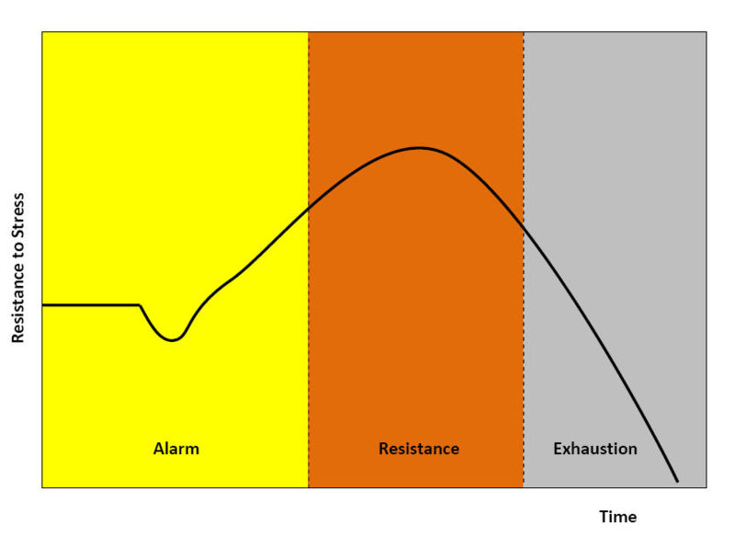
General Adaptation Syndrome

Slide 5
Level Of Stress:
Eustress
Perform
Calm
Distress
Level of Stress

Slide 6
Potential Sources of Stress:
A) Internal Factors
Inner conflicts
Perceptual Influences
Thresholds of stress
Motivational level

Slide 7
Potential Sources of Stress:
B) Environmental Stressors
Task Demands
Role Demands
  Inter role conflict
  Intra role conflict
  Person role conflict
Inter Personal Demands
  Abrasive Person
  Sexual Harassment
  Leadership Styles
Physical Demands

Slide 8
Managing Stress
Individual approaches- time management techniques, increasing physical exercise, relaxation training, expanding social support network.
Organizational approaches- improved personnel selection, realistic goal setting, increased employee involvement, improved organizational communication.

Slide 9
Preventive Stress Management
Primary Prevention: Intended to reduce, modify or eliminate the demand or stressor causing stress.
Second Prevention: Intended to alter or modify the individual’s response to e demand or stressor.
Tertiary Prevention: Intended to heal the individual symptoms of distress and strain.

Slide 10
Managing Stress Better????
Become aware of the stressors and the emotional, physical reactions.
Recognizing what can be changed
Reduce the intensity of the emotional reactions to stress
Learning to moderate our physical reactions to stress.
Build our physical reserves.
Maintaining our emotional reserves.

Slide 11
Crisis Management
A crisis is a major, unpredictable event that threatens to harm an organization and its stakeholders.
There are different sorts of crises:
Sudden crises – such as fire , explosion, natural disasters, workplace violence
Smoldering Crises – problems or issues that start out small and could be averted if some one would have paid attention.
Perceptual Crises – P&G used to have issue with their earlier corporate logo, which critics would claim were symbols of devil- worship : calling for boycotts of P&G products.

Slide 12
Crisis Management Team
Functions of CMT are:
Establish a strategic crisis management team.
Assessment of vulnerability, elimination or reduction of the probability of a crisis.
Preparation of a response plan to different potential crisis.
Responding to emergencies and direct emergency resources, plan activation.
Recovery and evaluation
Reduction of risk of crisis recurrence.

